Slide 1


Crypto Currencies, Blockchain, Decentralised Apps, Holochain & Holo
Holo
Philip Beadle - Holochain Chief Engineer

Slide 2
Welcome to the Wild Wild West of the Internet
Disclaimer: This is how I understand things to be.
It’s a complicated beast!!
There’s a lot to get through so unless I get it wrong let’s do questions at the end.
I reckon it’s like the internet in 1993!!
Holo

Slide 3
Bitcoin
Blockchain
Mining - Proof of Work, Proof of Stake
Open Source and Forks of coins
Decentralised & Distributed Applications
Ethereum - “Build unstoppable applications”
Issues with Bitcoin and Ethereum
Holochain - Think outside the Blocks
How does Holochain differ from Blockchain & Ethereum
Holo - Where the Crowd is the Cloud
Our ICO In progress now!!
Holo

Slide 4
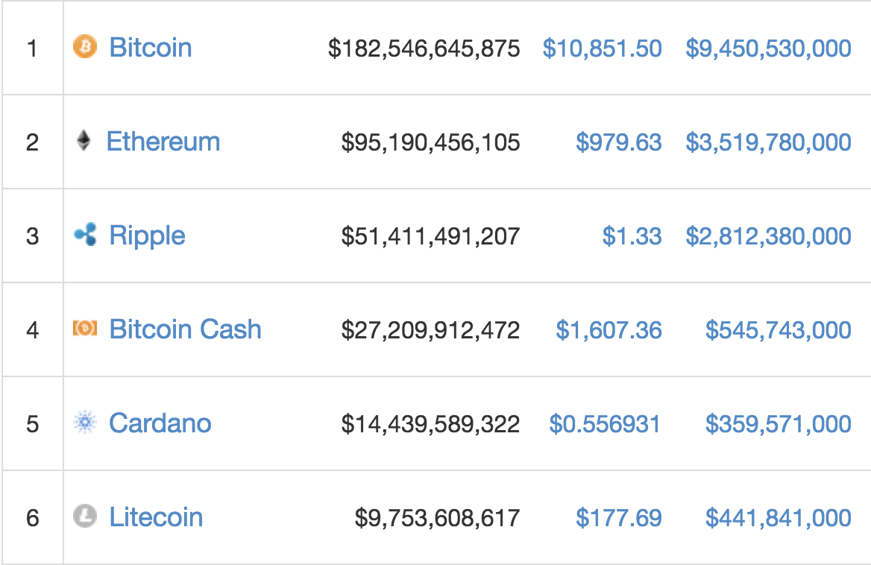
Crypto Currencies - Nov 2017
How to make a Bitcoin
f284bdc3c1c9e24a494e285cb387c69510f28de51c15bb93179d9c7f28705398
00000xxxxxxxxxxxxxxxxxx
2^256
How big is this?
Coin Market Cap
> $380 Billion
What is a wallet?
Private Keys
Trading
Exchanges
What is an ICO?
Powerledger

Slide 5
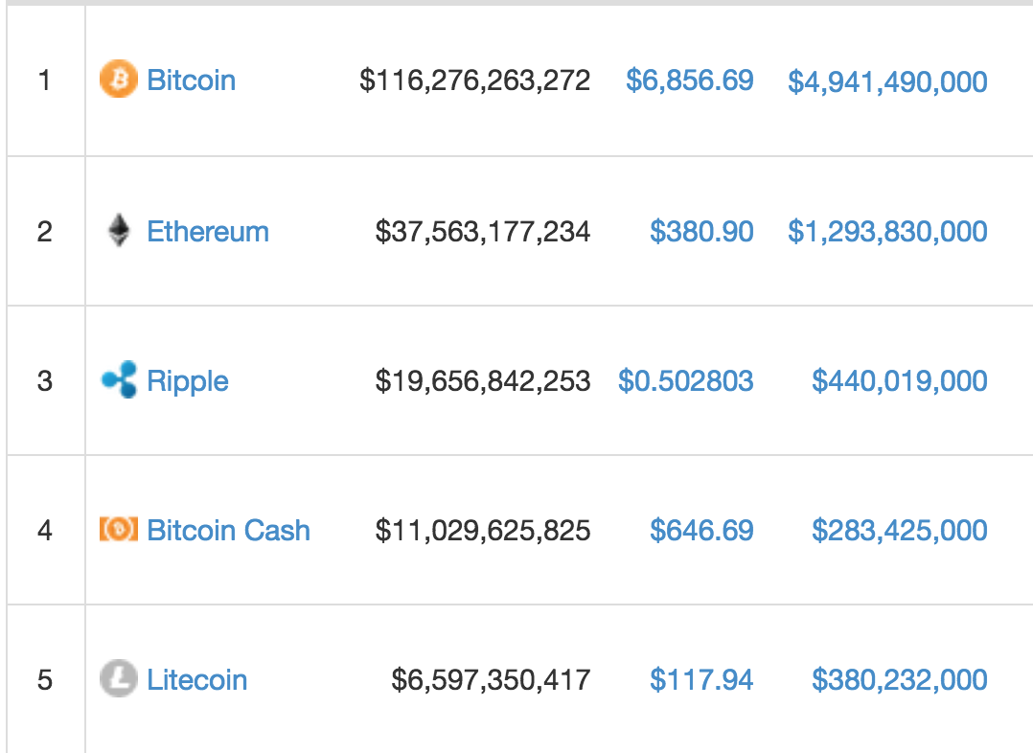
Volatility of Crypto & State Currencies - April 9

Slide 6
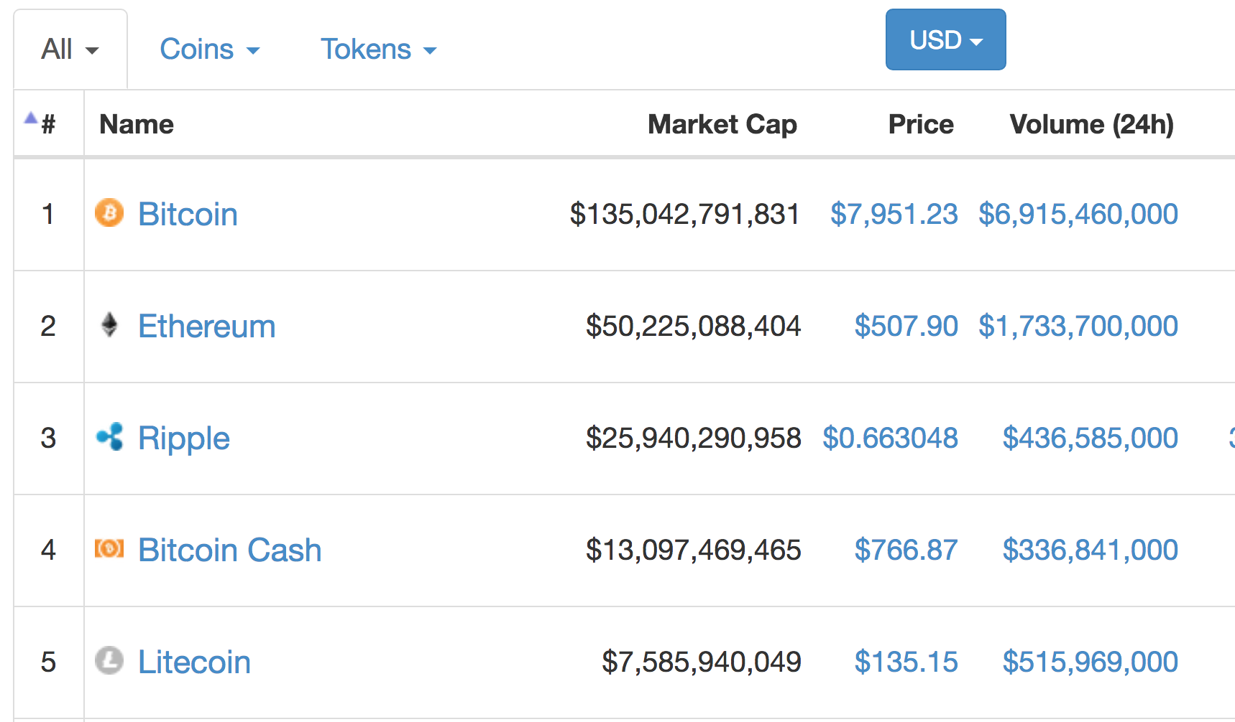
Volatility of Crypto & State Currencies - April 18
Lost 50% in 3 months - $180 Billion
FIAT - Breathed into being
Gambling Chips
In 10 years Bitcoin issuance and holding more centralised than state currencies.
Crypto “Whales”
Not value backed

Slide 7
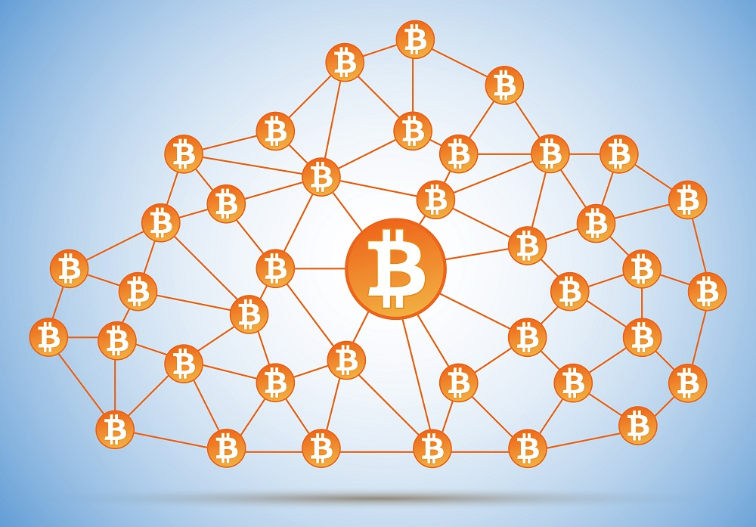
Blockchain
Blocks and chains?
Global Ledger
This technology is disrupting all trust based systems
Miners
Hashing (Find the nonce)
Mining Pools - shared reward and resources
ASIC - Application Specific Integrated Circuit
17.5 TH/s!!!! (17,500,000,000,000 / second!!!)
0.1% of the earth’s electricity - wasted
Pareto Effect - mining is controlled by a few HUGE miners!
PoW and PoS are centralising algorithms

Slide 8
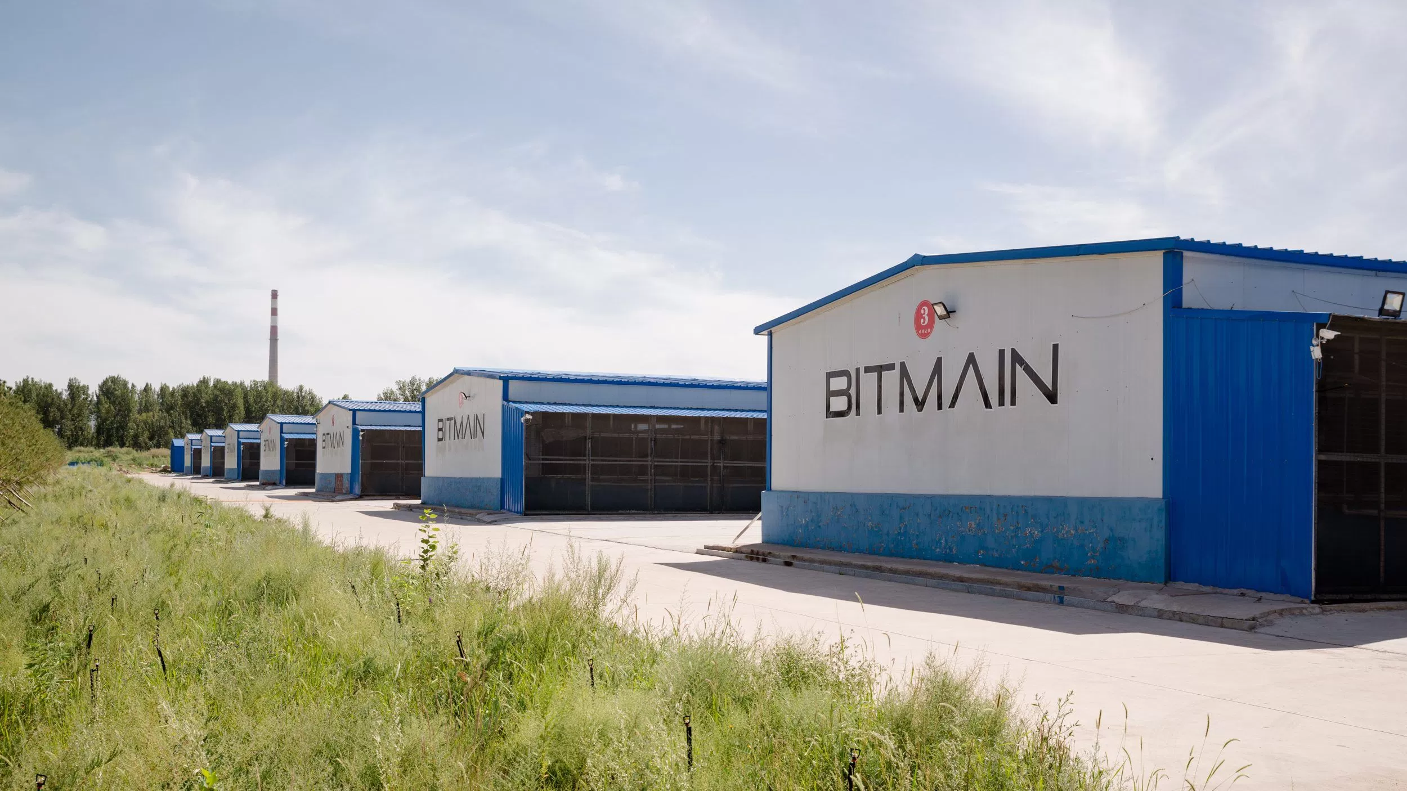
Blockchain - Jihan Wu’s BTC Mining Farm

Slide 9
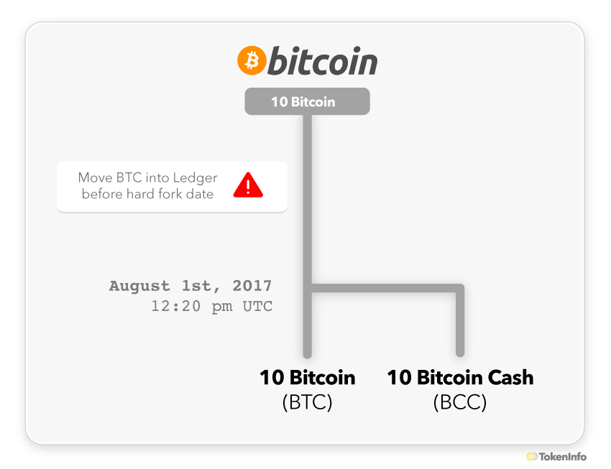
What is a Fork or Alt Coin?
Github Demo

Slide 10

Distributed Applications
Trustless - Thanks to the NSA!
Ethereum - World Computer
Smart Contracts
Solidity
Truffle
Gas
Ether
DAOs (Decentralised Autonomous Organisations)
Commonwealth Bank
25 POC’s, now have a marketable product
Commercial Banks
Liquidity Cost savings

Slide 11
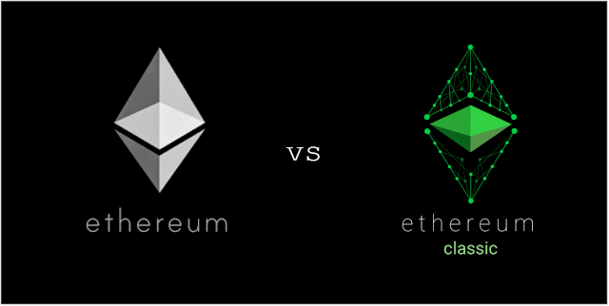
Issues with Ethereum
Size of the blockchain
No longer published!
4-5 weeks to synch
Gas limits
Cost of execution
Slowness of transactions and scaling
Vitalik: Ethereum Apps Are Being 'Screwed' By Scaling
Difficult to fix mistakes
Someone locked up 300 Million $ worth of Ether!!
Programming Smart Contracts
Everyone’s programs and data are shared to everyone
https://github.com/holochain/benchmarks

Slide 12
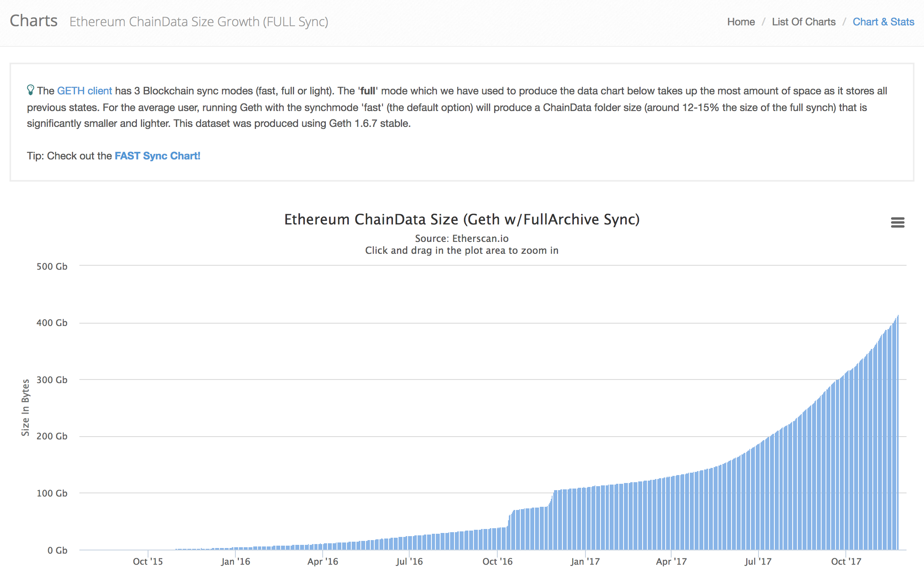
Size of Ethereum Blockchain November 17 410GB

Slide 13
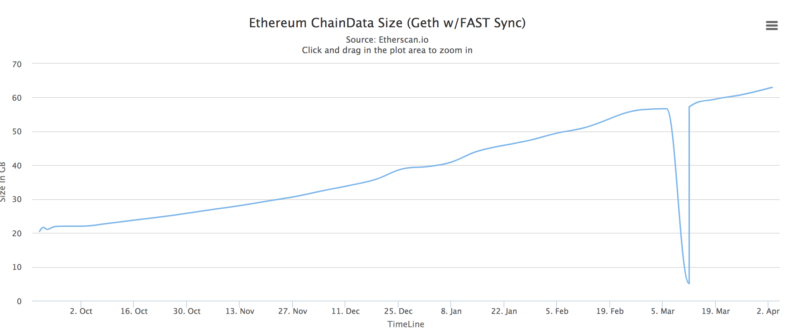
Size of Ethereum Blockchain April 2018 - Fast

Slide 14
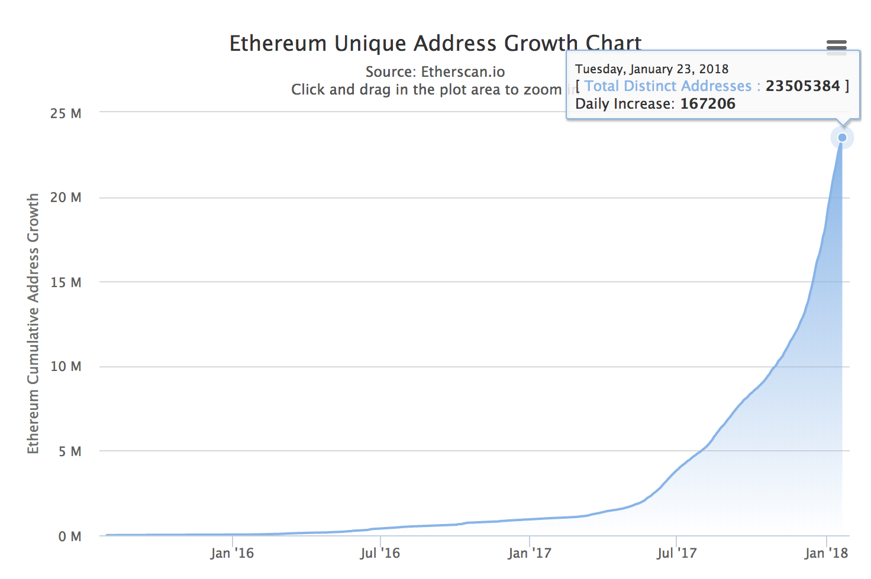
Users of Ethereum Blockchain
https://etherscan.io/chart/address

Slide 15
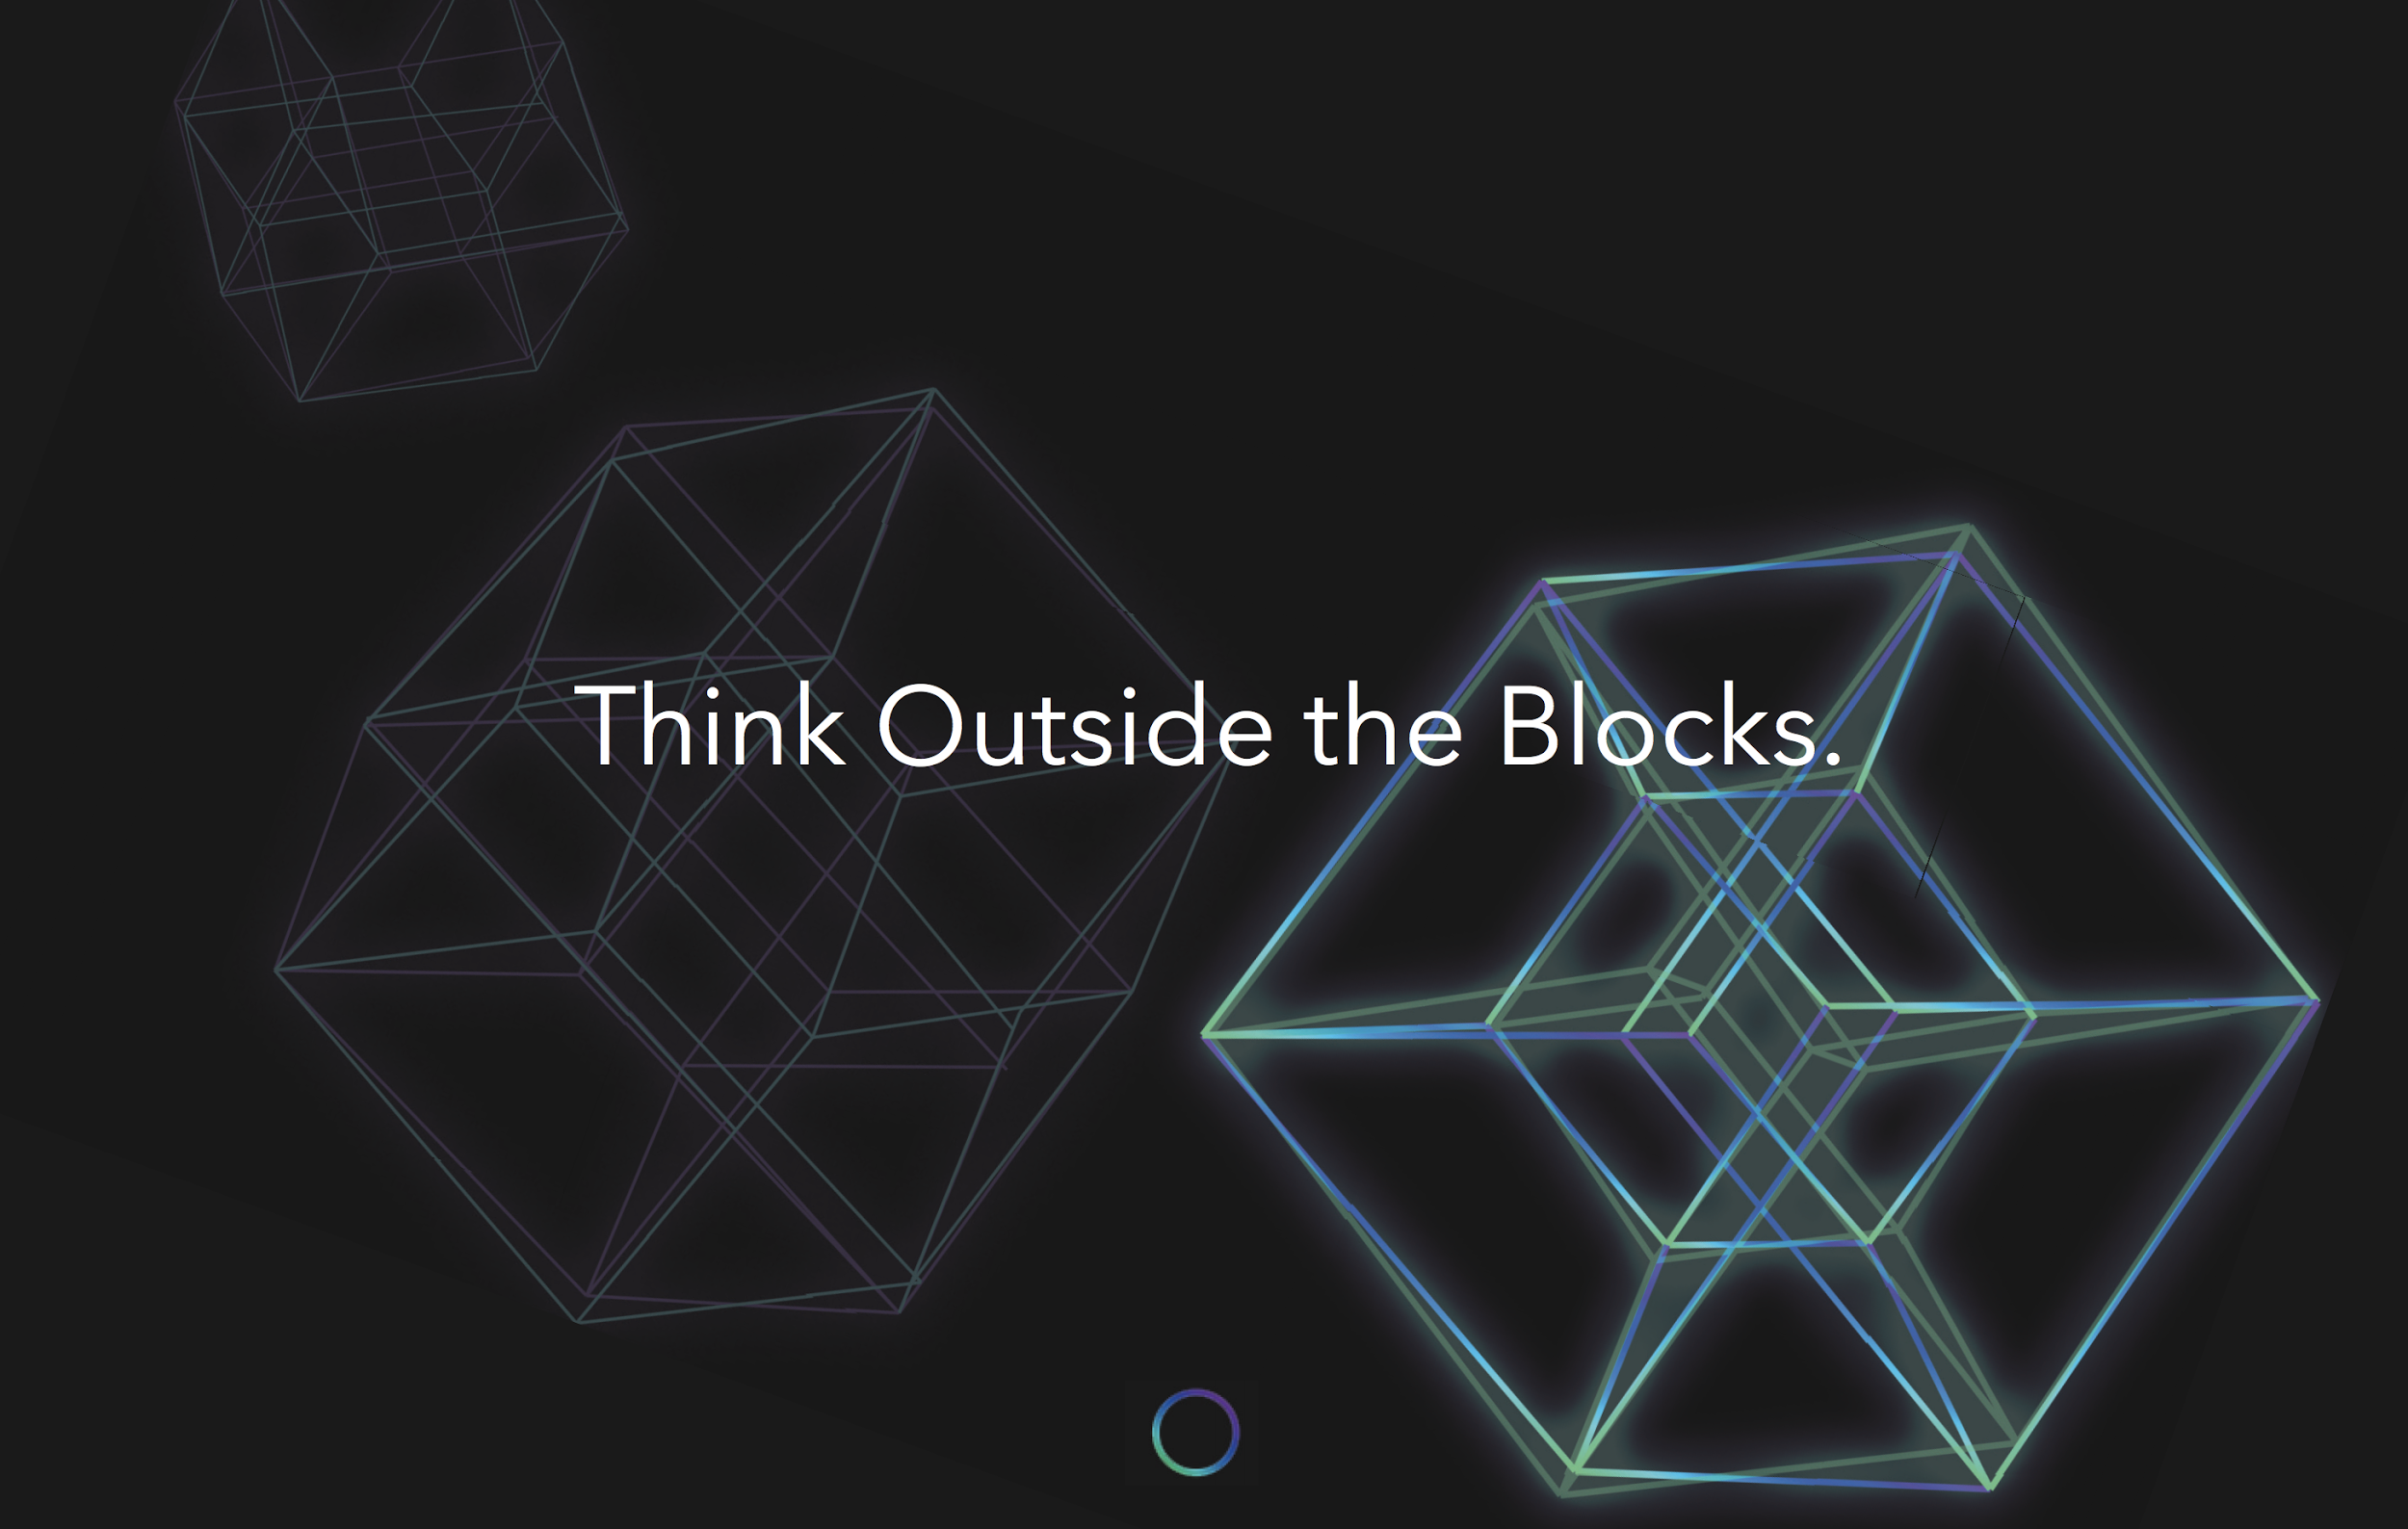

Slide 16
How is Holochain different?
First white paper was published before Bitcoin paper!
Holo

Slide 17
Agent Centric - No global ledger
Distributed Hash Table - Like Bit Torrent
Self Healing, Validating & Private DHTs
No mining, PoW, PoS & No Wasted Power - Sharded DHT Validation
Inversely Scalable - Super Fast Transactions (HOLO will do Billions per sec)
Works offline natively
Built in Testing Framework for Synchronous and Multinode Scenarios
Build your own Test Network with Docker
Use existing web development skills and patterns
Bio-mimicry
Holo

Slide 18
Let’s build an app
Belinda built this app in less than a day!
This app is a next generation peer 2 peer distributed crypto app
Easily supporting billions of transactions per second!!
Holo

Slide 19
Bio-mimicry
Nature runs a pretty amazing distributed application
Holo

Slide 20
Zomes
Short for Chromosone
A set of functions and entry types
Evolves as code changes
Holo

Slide 21
DNA
Complex instruction set
An evolving set of Zomes
Evolves as Zomes evolve
Holo

Slide 22
Cells
DNA supplied with energy and food
People supply energy and digital content
Evolves as DNA, content and people in group evolves
Holo

Slide 23
Brain Tissue
A group of cells with a selective membrane
Manages who can do what with the cells
Evolves as cells evolve
Holo

Slide 24
Your Multi Dimensional Holo Brain
Built from Brain Tissue
Each piece of Brain Tissue is part of other Brains
Evolves as Brain Tissues evolves
Cross Brain Communication
Holo

Slide 25
Ethereum vs Holochain
Benchmarks
Holo

Slide 26
Demo - Clutter (a group of cats) our Twitter Clone
Phil writes a meow
The first time the app is used a new chain is created and the code of the app is hashed and added to the “Genesis” entry.
The content of the post is added to Phil’s local chain (chain.db)
Its public so it’s shared to the DHT via Gossip (dht.db)
The “Gossip” protocol shares the meow to “near” nodes in the DHT (Bit Torrent)
Each person has their genesis entry checked to see if they should talk to another node
The content is validated to ensure it hasn’t been tampered with
The app then retrieves the “meow” from the DHT
The “meow” shows up in the UI for each person following Phil

Slide 27
Developing Holochain Apps - Show Me Code
Use your existing web developer skills and patterns
Use ES5-->6 to build REST endpoints that call the Holochain API - DNA
Event bus coming soon - Event Driven Microservice Architecture
Write tests TDD to build your DNA
Synchronous tests
Scenario tests make it easy to test multiple nodes interacting
Lots of variables to access to make it easy to test
Build your UI as you like. We are using React-Redux-MaterialUI
TDD again, we use Storybook, Specs and Cypress
Bridge other DNA into your DNA - Keys, Personal Info, Private DHTs
Use DNA Zomes as well
Deploy with Holochain App Store
Small & Frequent Changes, upgrade triggers clean up.

Slide 28
Developing Holochain Apps - Show Me Code
View the contents of the local Chain and DHT
Dump Chain & DHT to JSON, or DOT - Demo
Great debug info to trace issues
Use services like Travis and Github

Slide 29
Holochain Initial Community Offering
New asset class - HoloFuel, value backed, peer created value
Holochain, HOLO and HoloPorts
Works now, alpha, ready to build apps on - not just a white paper
Sharded DHT validation, no PoW, PoS
Earn income with a HoloPort
Privacy, Data Integrity, Agency
Forking as a tool
Abundance not Scarcity
https://holo.host
1/10,000th cost of Ethereum Hosting

